Slide 1
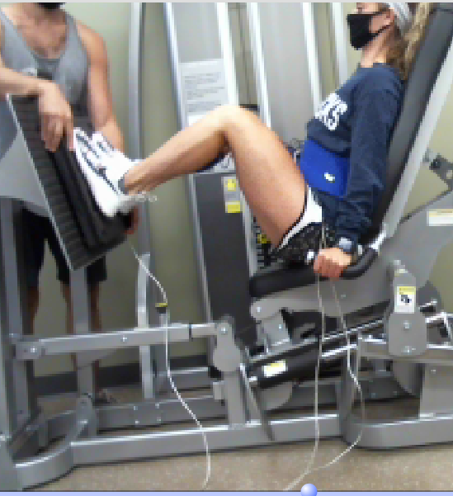
We will look at a place where the person is holding the platform still so forces and torques are balanced
Leg Press
https://www.pinterest.com/pin/leg-press--861383866216316692/

Slide 2
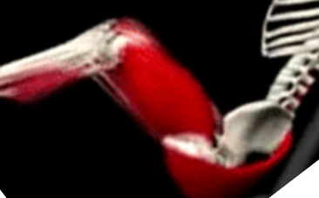
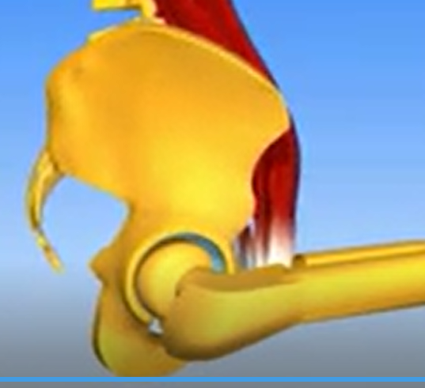
Limb system: whole leg
Joint: hip
Leg Press
4 pts.
Drag to show each muscle force and its torque rotation direction
Gluteus Maximus
Psoas
Extension
Flexion

Slide 3
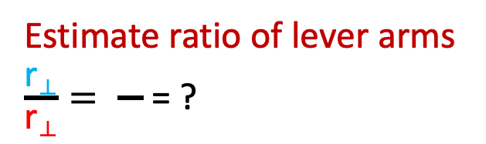
Leg Press
Limb system: whole leg
Joint: hip
Drag to indicate torque rotation direction of platform force
Drag and reorient force of leg press platform on foot/leg
1 pt.
1 pt.
F_{platform on leg}
Flexion
Extension
Which muscle can provide counter-torque to force of platform on leg/foot?
Psoas
2 pts.
Gluteus
Drag and reorient muscle force vector
2 pts.
r⊥
r⊥
2 pts.
Estimate ratio of lever arms
$\frac{\text{r}\text{⟂}}{\text{r}\text{⟂}}= \frac{}{}$ = ?
Drag lever arms for each force
2 pts.

Slide 4
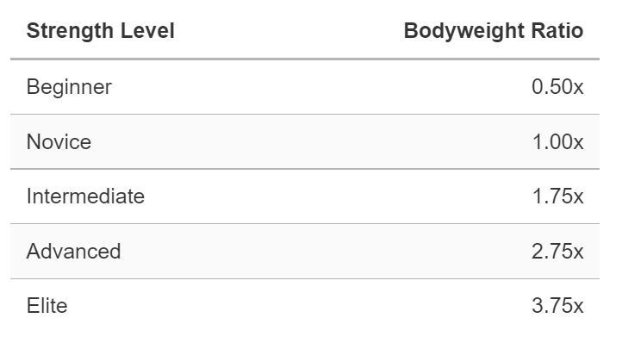
Female Horizontal Leg Press Standards
Choose level and platform force relative to body weight (for both legs)
For one leg it would be half of that
F_{platform each leg} = ? W_{body}
1 pt.
https://strengthlevel.com/strength-standards/horizontal-leg-press
On following page, show your strategy to find muscle force, starting from the torque balance equation, Σ𝝉 = 0,
either by using the equation editor, writing digitally (touchscreen), or rearranging symbols provided.

Slide 5
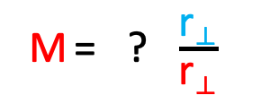
Algebra
Show by using the equation editor, writing digitally (touchscreen), or rearranging symbols provided.
Στ = 0
τ_{M}
τ_{bar}
(
)
In terms of individual torques
1 pt.
=
/
In terms of force times lever arm for each torque above
*
M
F_{platform}
M
F_{platform}
1 pt.
*
r⟂
r⟂
r⟂
r⟂
=
/
Rearrange equation to isolate M in terms of the lever arm ratio
M = ? $\frac{\text{r}\text{⟂}}{\text{r}\text{⟂}}$
1 pt.
Numbers
Put values in equation
1 pt.
W_{body}
M = ? * ?
Calculate to get result, in terms of body weight.
1 pt.
M = ?
W_{body}

